Slide 1
BLINKIT ANALYSIS
USING PYTHON
BY ASHWINI N

Slide 2
INTRODUCTION
Blinkit, formerly known as Grofers, is a leading quick commerce (q-commerce) platform in India, renowned for its rapid delivery of groceries and daily essentials. The company has effectively harnessed machine learning (ML) and artificial intelligence (AI) to enhance various aspects of its operations, from personalized customer experiences to efficient inventory management.

Slide 3
BUSINESS
1.Total Sales: The overall revenue generated from all items sold.
2. Average Sales: The average revenue per sale.
3. Number of Items: The total count of different items sold.
4. Average Rating: The average customer rating for items sold.

Slide 4
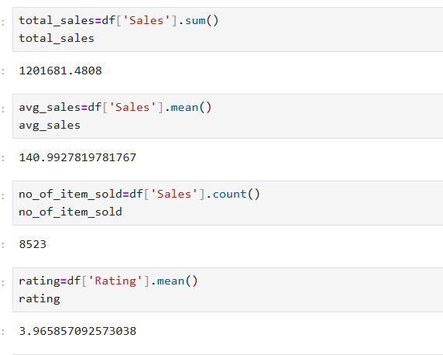

Slide 5
CHART’S REQUIREMENTS
1.Total Sales by Fat Content:
Objective: Analyze the impact of fat content on total sales.
Chart Type: pie Chart.
2. Total Sales by Item Type:
Objective: Identify the performance of different item types in terms of total sales.
Chart Type: Bar Chart.
3. Total Sales by Item Type & Fat Content :
Objective: Identify the performance of different item types with fat content
in terms of total sales.
Chart Type: Bar Chart.
4.. Fat Content by Outlet for Total Sales:
Objective: Compare total sales across different outlets segmented by fat content.
Chart Type: Column Chart.

Slide 6
5.Total Sales by Outlet Establishment:
Objective: Evaluate how the age or type of outlet establishment influences total sales.
Chart Type: Line Chart.
6. Sales by Outlet Size:
Objective: Analyze between outlet size and total sales.
Chart Type: Donut/ Pie Chart.
7. Sales by Outlet Location:
Objective: Assess the geographic distribution of sales across different locations.
Chart Type: Funnel Map.
8.Total Sales by Outlet and Fat Content:
Objective: Identify the performance of different outlet with fat content
in terms of total sales.
Chart Type: Bar Chart

Slide 7
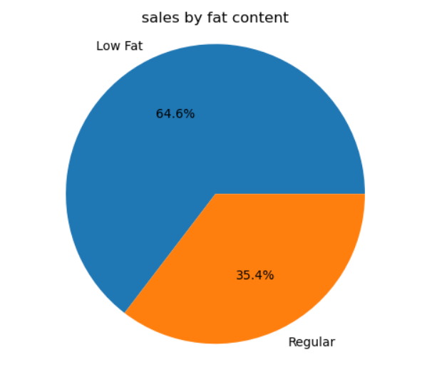

Slide 8
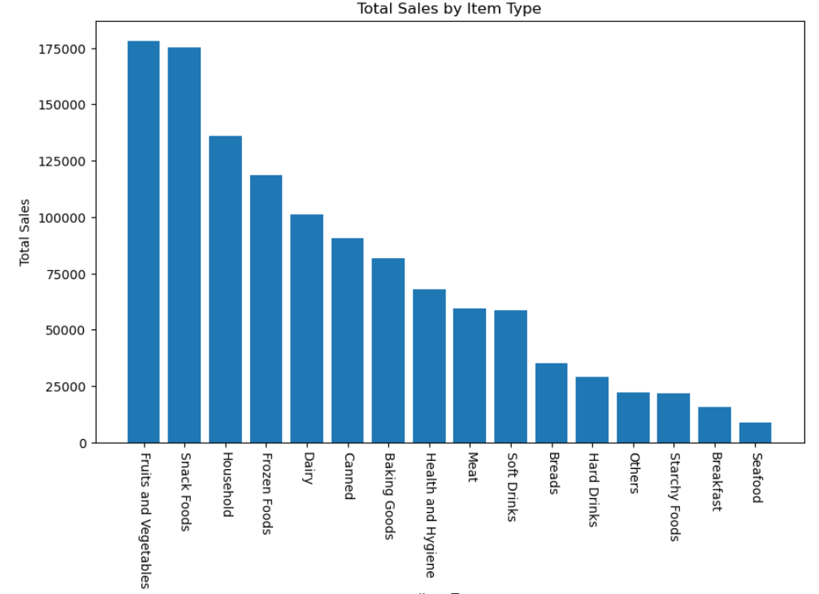

Slide 9
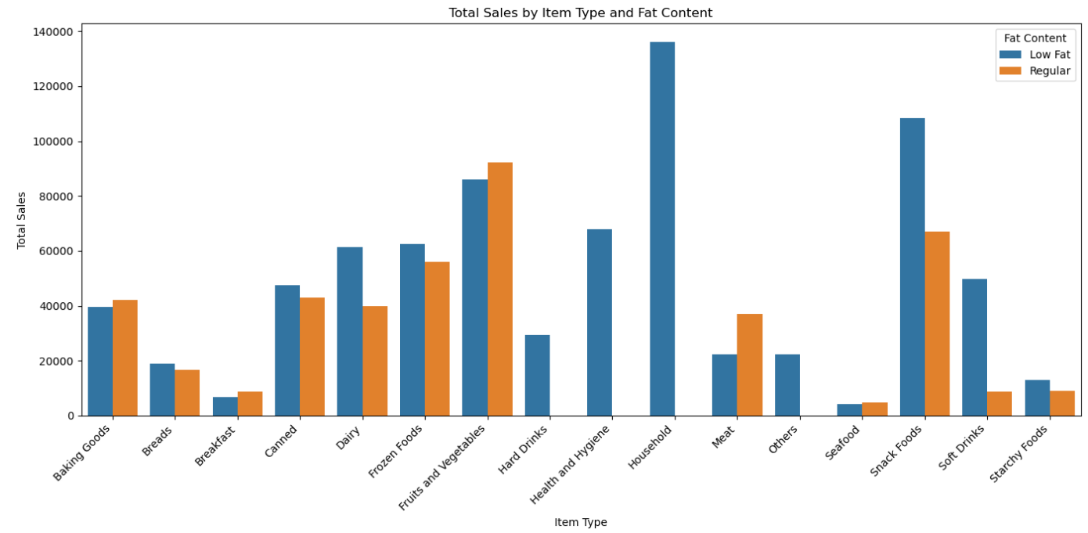

Slide 10
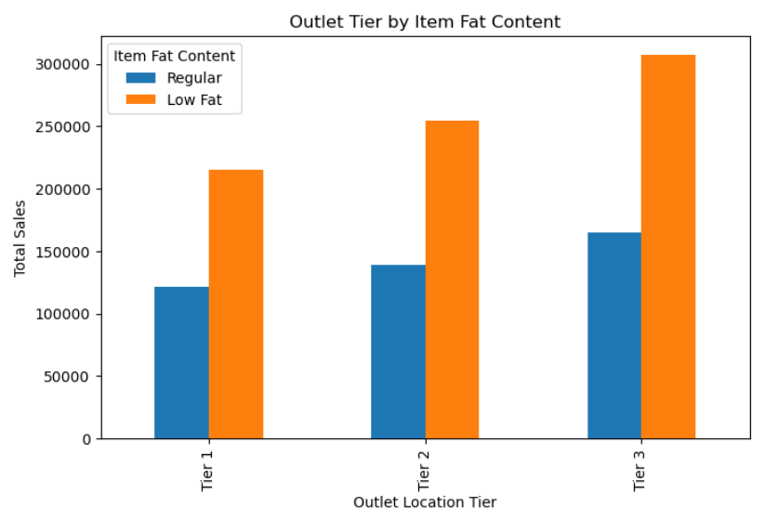

Slide 11
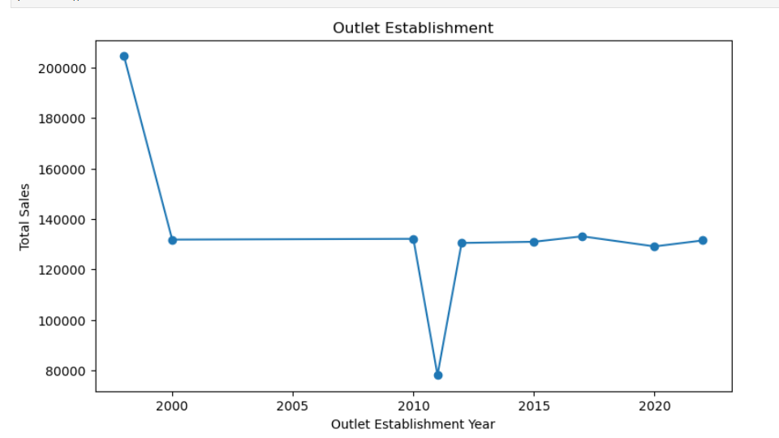

Slide 12
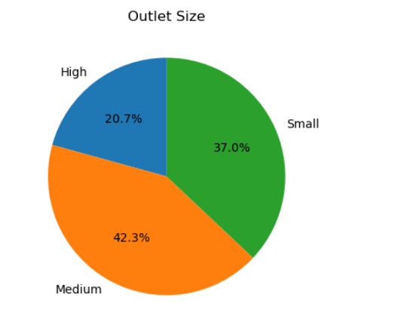

Slide 13
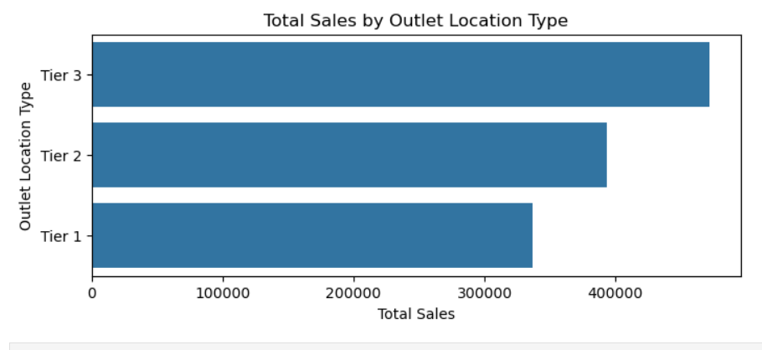

Slide 14
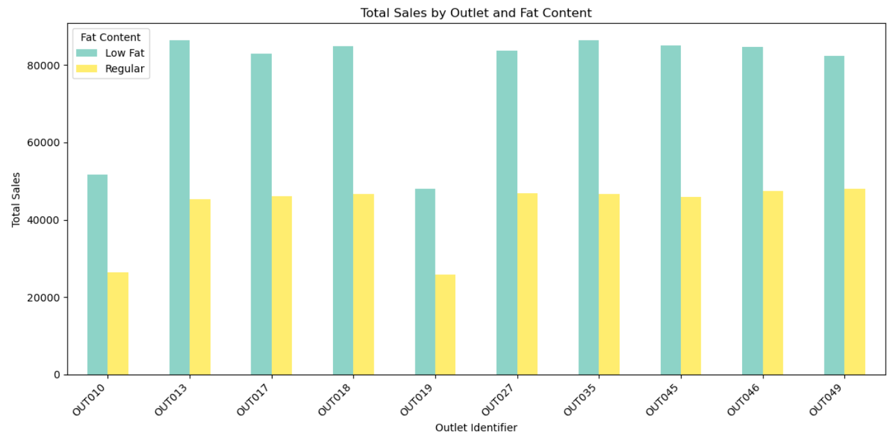

Slide 15
CONCLUSION
Blinkit has emerged as a frontrunner in India’s quick commerce landscape, leveraging speed, convenience, and operational efficiency.
With a strong focus on technology, supply chain optimization, and customer experience, Blinkit is well-positioned for sustainable expansion
However, challenges such as intense competition, regulatory scrutiny, and market saturation remain.
Continued innovation and strategic adaptability will determine its long-term leadership in this fast-evolving market.

Slide 16
THANKYOU

